Slide 1
Skytrax Customer Analytics System
- for Global Airlines Industry
A Capstone Project
By
Vincent Yap

Slide 2
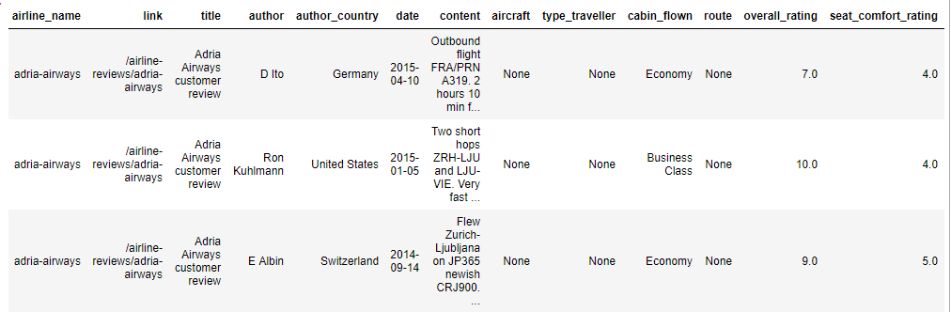
Data – Customers Review
Passengers review of their trip.
  41396 rows by 21 columns.
    Airline Name, Review Content, Author Name & Country, Cabin Flown, Aircraft, Traveller Types, Routes, Date, Link
    Seating Rating, Cabin Staff Rating, Food & Beverages Rating, Inflight Entertainment Rating, Ground Service Rating, Wifi_Rating
    Overall Rating, Recommended, Value for Money Rating

Slide 3
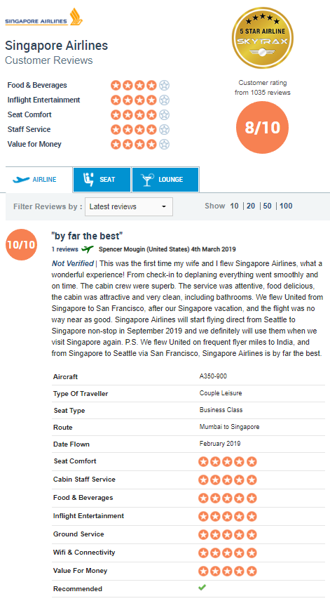
Review on Skytrax Website

Slide 4
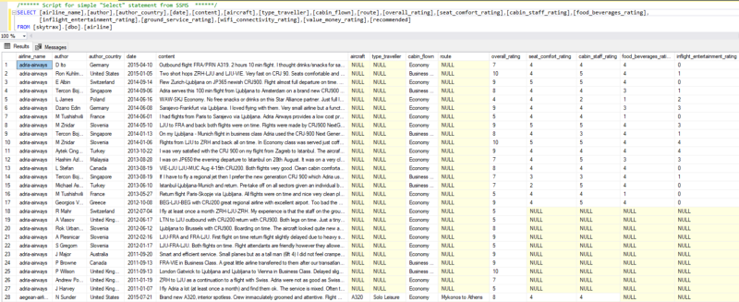
SQL Server 2016

Slide 5
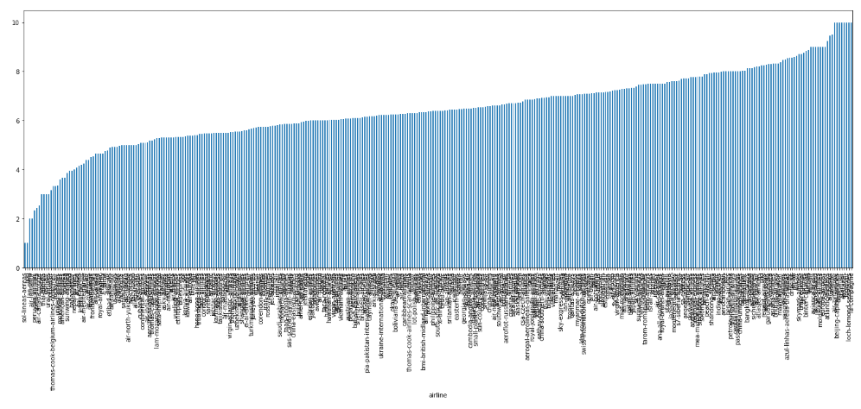

Slide 6
EDA
Checked for any imbalances in the data.
Dropped columns with 95% nulls.
  Ground_service_rating, Wifi_connective_rating
  Traveller types
Dropped duplicate, any null valued rows and irrelevant features
  Author name, Date, Route, link, title
Median or mean
Neutral score of 3 (Rating range is from 1 to 5)

Slide 7
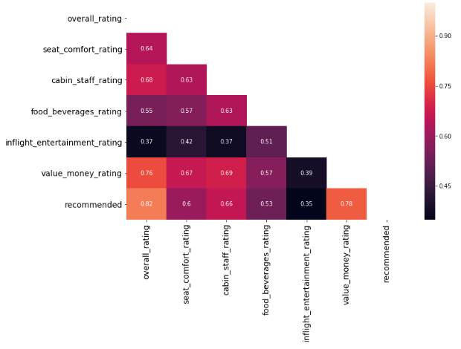
Data Preparation
Using Labelencoder, Getdummies, Factorize, and manual coding for:
    Cabin Class:
      Econonmy, Business, First, Prem-Economy
    Author_Country:
      Nationality of the reviewers
    Recommended:
      True or False
Investigating Linear relationships

Slide 8
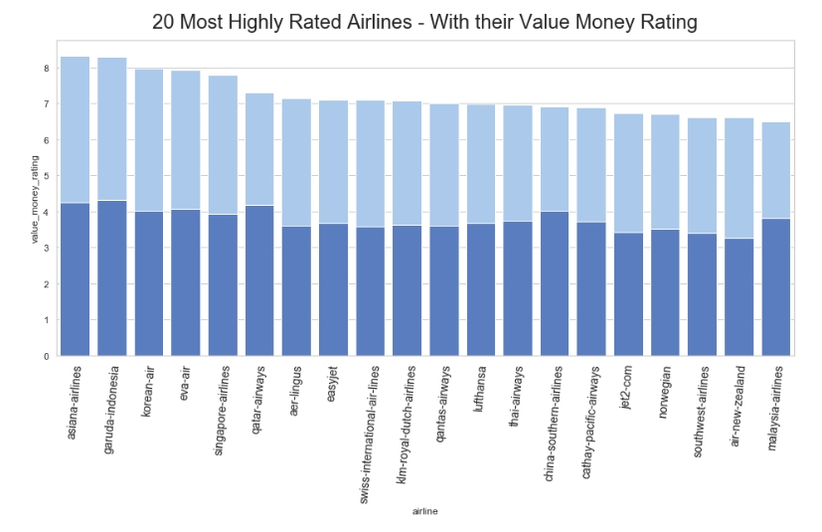

Slide 9
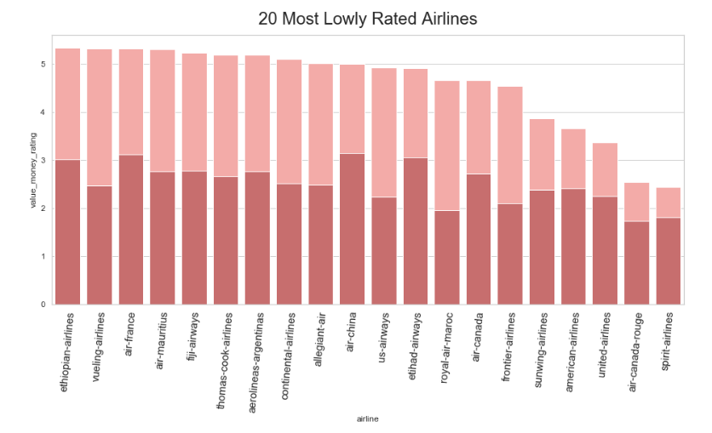

Slide 10
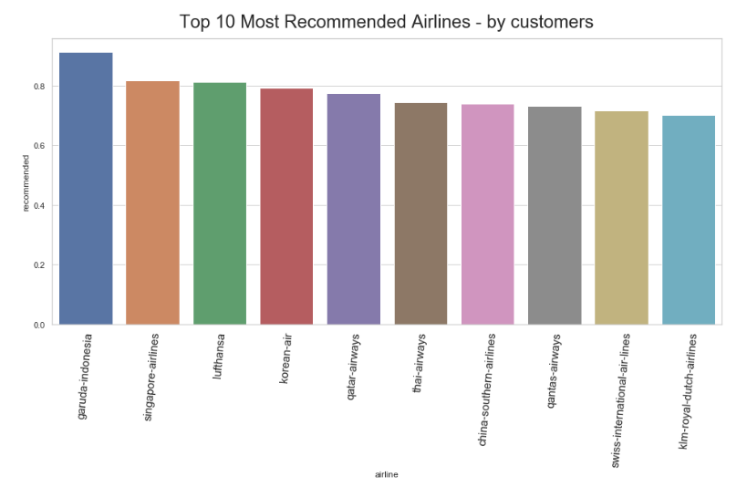

Slide 11
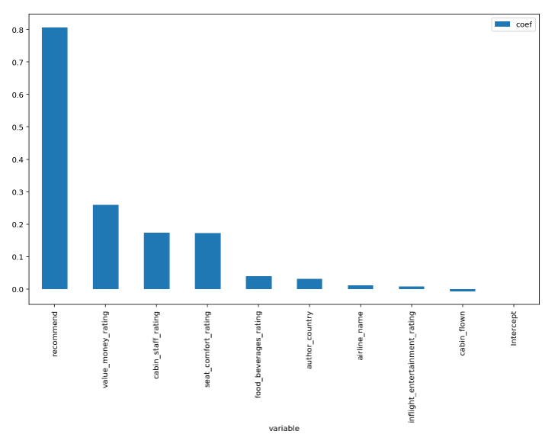
Which aspect of a flight best predicts a customers' overall rating of an airline?

Slide 12
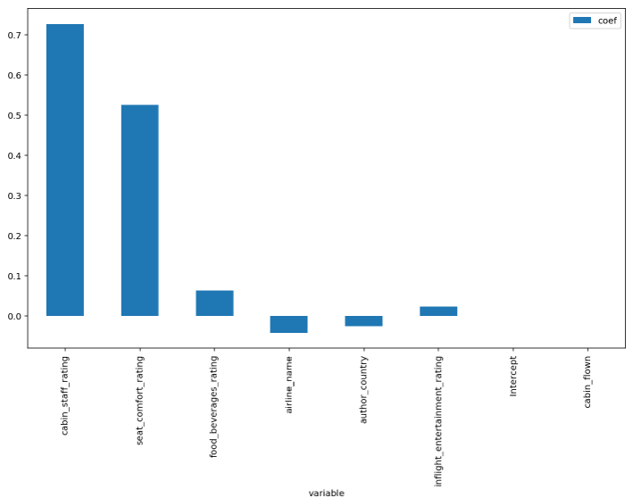
Which aspect of a flight best predicts “value money rating” for “Budget Airlines?

Slide 13
Test Scores:
Lasso - 73.35%
Lasso + GridSearch = 78.34%
ElasticNet – 73.30%
Random Forest – 77.17%
Random Forest + Randomized search
(hyper parameters) – 77.89%
PCA + Stochastic Gradient Descent – 73.40%

Slide 14
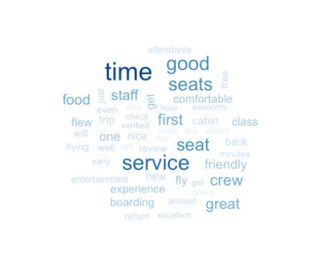
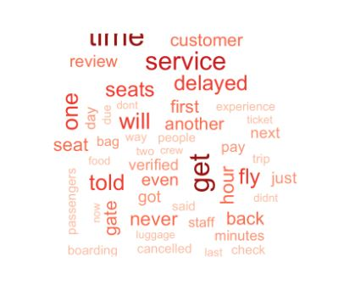
What words come up most frequently?
In positive reviews? And in negative reviews?

Slide 15
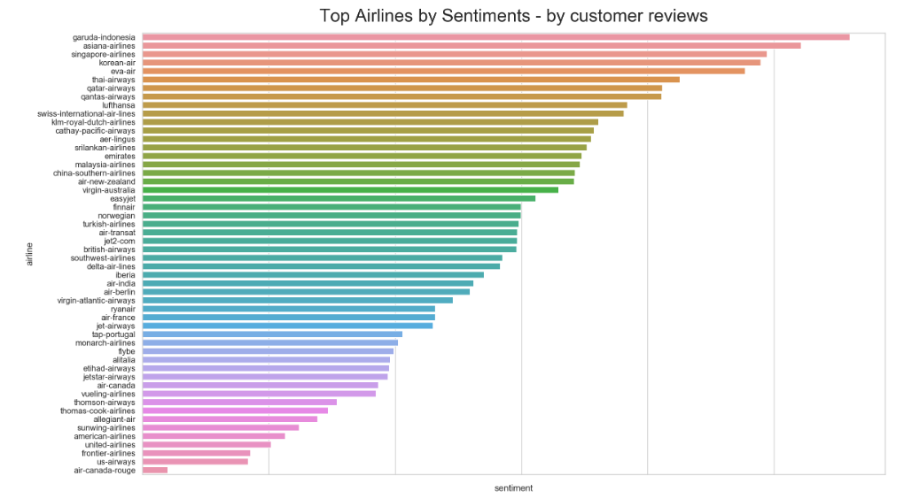

Slide 16
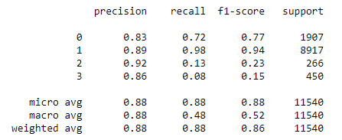
Predicting reviewer‘s cabin class from review
KNN – 83.04%
Random Forest – 88.46%

Slide 17
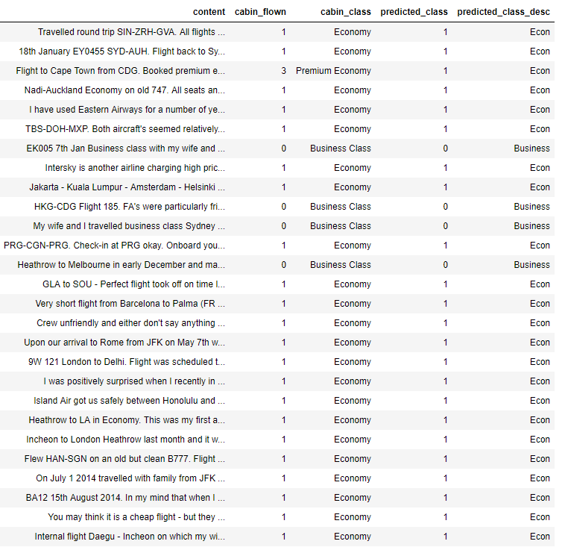
Predicting reviewer‘s cabin class from review

Slide 18
Summary
Cabin Service - Most critical in the air industry regardless if it is a budget airline or a major commercial airline
Time Saving – saving time is second most critical predictor as flight delayed impact overall rating as well as value money rating, recommended flag.
Seats – comfort of a seat is the third most important feature.

